Slide 1
CHAPTER 5: Dataset manipulation
Day 3

Slide 2
CHAPTER 5: Dataset manipulation
Now we have a Data Set put together.
Let’s add some delinquency information.

Slide 3
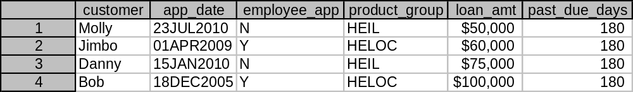
CHAPTER 5: Data set manipulation
We’ll create a dataset named ‘loan_dq’ by using our loan_info_combine dataset and add Delinquency information to it.
First make sure you format your new variable ‘past_due_days’.
Of course not everyone is past due 180 days, but how do we get specific to each customer?
data loan_dq;
format past_due_days 5.0;
set loan_info_combine;
past_due_days=180;
run;
OUTPUT

Slide 4
CHAPTER 5: Dataset Manipulation
The ‘IF THEN DO’ clause!
if this is true then do; /*sets the condition */
this statement;
this statement;
this statement;
end; /* tells SAS this loop is done */

Slide 5
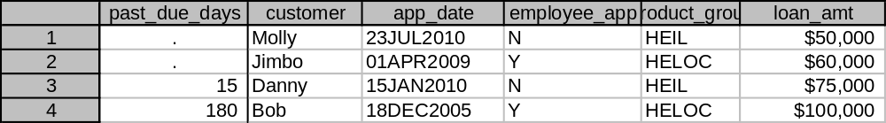
CHAPTER 5: Dataset Manipulation
Let’s give Danny and Bob their own Delinquencies.
We create a new dataset customer_past_due and use ‘IF THEN DO’ clauses.
data customer_past_due;
format past_due_days 5.0;
set loan_info_combine;
if customer=“Danny" then do;
past_due_days=15;
end;
if customer="Bob" then do;
past_due_days=180;
end;
run;
OUTPUT

Slide 6
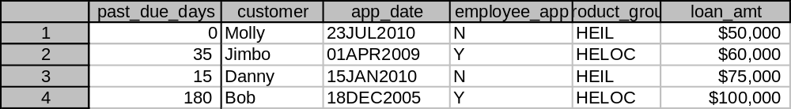
CHAPTER 5: Try on your own 1
Use this code but add the following
Past_due_days of 0 for Molly and 35 for Jimbo.
data customer_past_due;
format past_due_days 5.0;
set loan_info_combine;
if customer=“Danny" then do;
past_due_days=15;
end;
if customer="Bob" then do;
past_due_days=180;
end;
run;
OUTPUT

Slide 7
CHAPTER 5: Try on your own 1
(Solution)
data customer_past_due;
format past_due_days 5.0;
set loan_info_combine;
if customer="Molly" then do;
past_due_days=0;
end;
if upcase(customer)="JIMBO" then do;
past_due_days=35;
end;
if customer="Danny" then do;
past_due_days=15;
end;
if customer="Bob" then do;
past_due_days=180;
end;
run;

Slide 8
CHAPTER 5: Dataset Manipulation
Not only can you use the ‘IF THEN DO’ clause to add values to specific rows, you can ALSO choose which rows you want to keep in the dataset and which you want to leave out.

Slide 9
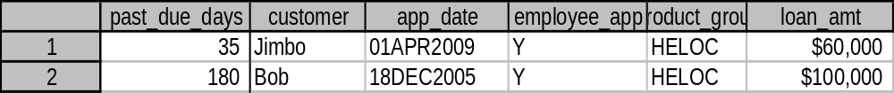
CHAPTER 5: Dataset Manipulation
Lets take the dataset ‘customer_past_due’ we just created and make a new dataset called ‘only_dq_loans’ with only 30+ past due loans.
Make the condition: if past_due_days >=30 is true, then output the row.
data only_dq_loans;
set customer_past_due;
if past_due_days >= 30 then do;
output;
end;
run;
OUTPUT ==>

Slide 10
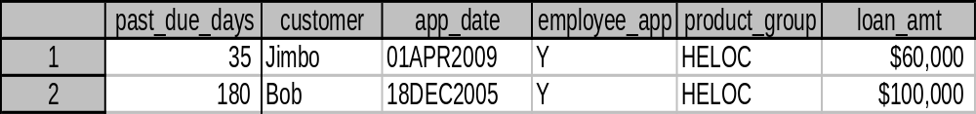
CHAPTER 5: Dataset Manipulation
Taking it further, lets create a dataset called employee_dq_loans’ from the ‘customer_past_due’ with employee accounts past due more than 0 days (past due at all).
data employee_dq_loans;
set customer_past_due;
if employee_app="Y" and past_due_days > 0 then do;
output;
end;
run;
OUTPUT ==>

Slide 11
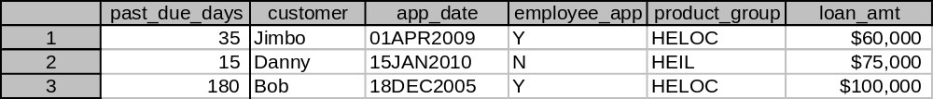
CHAPTER 5: Try on your own 2
Make a new dataset named ‘large_past_due’ from the ‘customer_past_due’ table with accounts that are 30+ past due OR have loans greater than $70,000.
data large_past_due;
set customer_past_due;
if ‘add statement’ ……..
run;
OUTPUT
Hint!: Remember ‘and’ in the condition statement ‘if employee_app="Y" and past_due_days > 0 then do;’ connected the two conditions? Do the same with ‘or’.

Slide 12
CHAPTER 5: Try on your own 2
(Solution)
data large_past_due;
set customer_past_due;
if past_due_days >= 30 or loan_amt >70000 then do;
output;
end;
run;

Slide 13
Logical Reversal
Opposite of: Loan < 10 ➔ Loan >=10
Opposite of: Loan = 10 ➔ Loan ^=10
    ^ means ‘not’ so ^= means ‘not equal’
Opposite of: ‘and’ ➔ ‘or’

